Slide 1
Angular Training
Intermediate Level
Abhijit Simha R

Slide 2
Setup:
Node Version:
node --version
OPTUM’s npm registry: npm config set registry https://repo1.uhc.com/artifactory/api/npm/npm-virtual/ --global
Angular setup:
npm install -g @angular/cli

Slide 3
Create a workspace and initial application
Cmd: ng new my-app
No for strict type checking.
Select Yes(Y) for Routing.
Select SCSS for Styling.
Download VS code Editor. Link: https://code.visualstudio.com/download

Slide 4
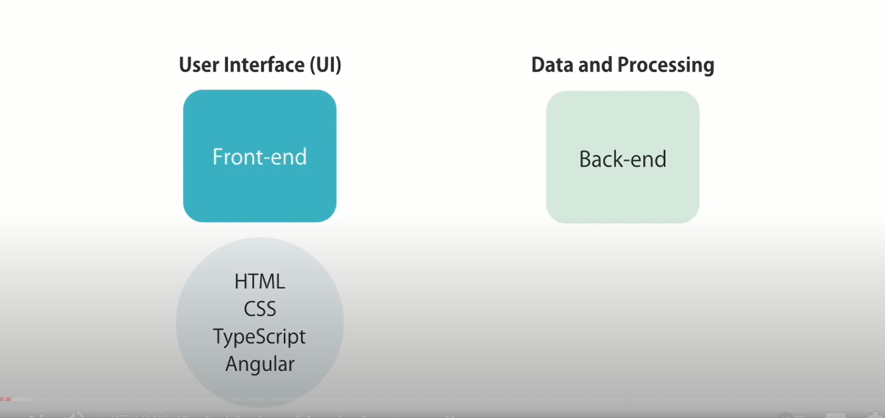
Angular Basics

Slide 5

Angular Basics
Applications that are contained within one web page are called single-page applications (SPA).
All the views are displayed in one page i.e., “index.html”.

Slide 6
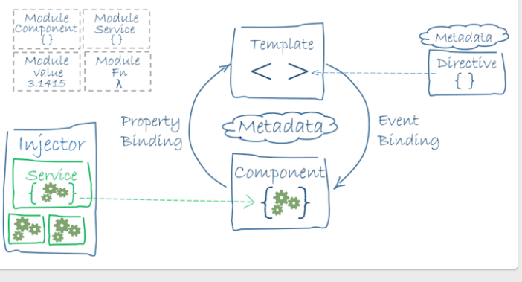
Angular Architecture
Module
Root Module

Slide 7
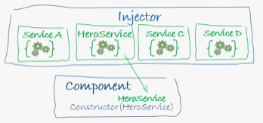
Dependency Injection

Slide 8
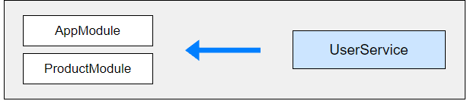

Provider Scope
Root Module Level (Application Level).
Module Level.
Component Level.
Root Module (Application Level) & Lazy Loaded Module Level (Lazy Loaded Module’s unique instance).

Slide 9
Angular Modularity
Modules are a great way to organize an application and extend it with capabilities from external libraries.
The Angular framework itself is a set of JavaScript modules.
Frequently used Angular modules :
BrowserModule
CommonModule
FormsModule
ReactiveFormsModule
RouterModule
HttpClientModule

Slide 10
Types of Modules
Root Module
Core Module
Feature Modules
Routing Modules
Shared Modules
Service Module

Slide 11
Routing
Routing allows us to navigate through all the views by configuring the route for each component that will display a view.
Navigating through Angular Application Routes
Menu option, link, image, buttons chained with click events activates a route.
Typing the URL in URL address bar.
Browser’s forward, backward buttons.
Route Configuration Eg: <base href=“/”> // index.html RouterModule.forRoot([ { path: ‘home', component: BbbCompComponent } ]), //AppModule.ts

Slide 12
Route declarations
const routes: Routes = [ // maps specific URL path segement { path: 'home', component: PcompComponent },
// specifies a router param and maps the specific URL path segment { path: 'product/:id', component: ProductDetailComponent },
// specifies & maps a empty route { path: '', redirect: 'home‘, pathMatch: ‘full'},
// specifies & maps a wildcard path route { path: '**', component: PageNotFoundComponent}];

Slide 13
Location Strategies in Angular Router
HashLocationStrategy Eg: http://localhost:4200/#/product
uses the anchor tags technique to achieve client-side routing.
PathLocationStrategy Eg: http://localhost:4200/product
HTML5 allows browsers to programmatically alter the browser’s history through the history object.
Default strategy in Angular application

